Slide 1
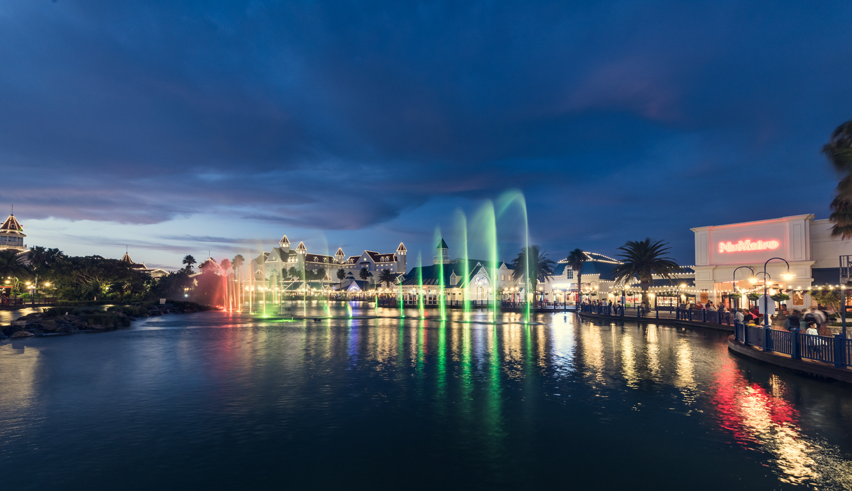
Positioning for future growth
Hotels Outlook: 2018 – 2022
South Africa – Nigeria – Mauritius – Kenya – Tanzania • Eighth edition, July 2018
www.pwc.co.za
Notes:
Front cover slide with fixed logo

Slide 2
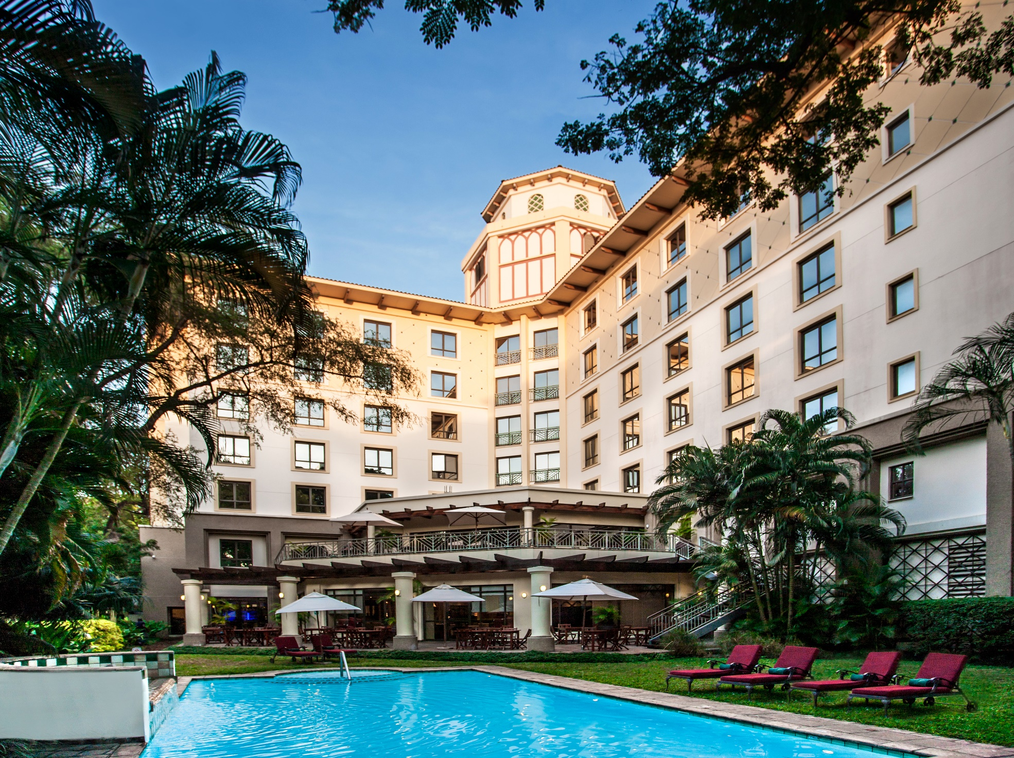

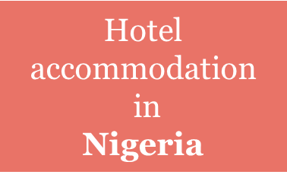

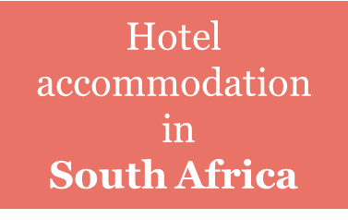
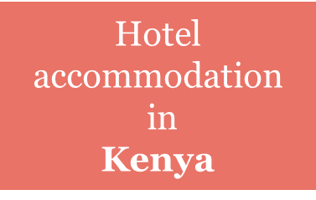
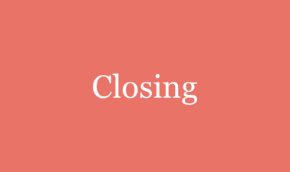
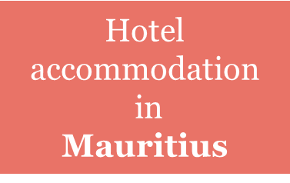
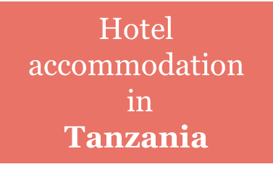
Agenda

Slide 3
Introduction
  This is the eighth edition of our annual Hotels report:
    Provides data on accommodation revenues for the hotel sector in South Africa, Nigeria, Mauritius, Kenya and Tanzania. Revenue from food & beverage and other services is excluded.
  Aims to provide synopsis of historical performance for 2017 and forecast revenue and other key trends for the 2018 – 2022 period.
The hotel market in each country is affected by both the local and global economy, with some countries being more dependent on foreign visitors than others.
The edition looks at particular topics including: The Cape Town water shortage, What is next for the Kenya hotels market and Cybersecurity and privacy.

Slide 4
Hotel accommodation in South Africa

Slide 5
Key highlights for 2017
South Africa
Average
room rates
Guest nights
Occupancy rates
Revenue
13
13
0.7%
13.8 million
4.6%
R16.6 bn
61%
vs. 61.2%
3.9%
Key themes for 2017:
Number of available rooms rose 1.3% in 2017, continued increase in visitor numbers, ADR, revenue growth and continued investment.

Slide 6
Foreign visitors
South Africa
Foreign tourism rose 2.4% in 2017, building on its 12.8% increase in 2016. Growth impressive as it was without any boost from a weak rand. Increase in visitors from non-African countries of 7.2%.
Latin America recorded the largest increase in 2017 with a 59.3% gain.

Slide 7
Foreign visitors
South Africa
Brazil, France and Germany recorded the largest increases.
Visitors from China fell 17.0% in 2017. Travellers from India rose a modest 2.7% in 2017, well below the 21.7% increase recorded in 2016.

Slide 8
Foreign and Domestic visitors
South Africa
Tourism contributed 9% to South Africa’s GDP in 2017. Helped by an improving economy, domestic travel showed the largest increase since 2014, rising 4.2% in 2017.
Global economy, a key driver of foreign tourism, picked up noticeably in 2017 with a 3.0% gain, its largest increase since 2010.
Total number of travellers in South Africa will reach a projected 19.5 million by 2022, a 4.0% compound annual increase from 16 million in 2017.

Slide 9
Hotel revenue
South Africa
 | Revenue of R5.2 billion in 2017, increase of 5.1% 65.4% (2016: 64.6%) occupancy in 2017 & ADR of R980 a 3.2% increase.
 | Revenue increased by 5.7% to R6.1 billion in 2017 66.1% (2016: 65.5%) occupancy in 2017 & ADR of R1 445
 | Revenue of R2.7 billion in 2017 which is 8.8% up on 2016 ADR of R2 960
With a number of four-star hotels opening in 2017, available rooms increased 1.8%, the first rise since 2013.
Five-star hotels had the highest occupancy rates in the market in 2017, at 79.5%.

Slide 10
Major cities analysis
South Africa
Johannesburg
Guest nights fell by 1%. Festive season guest nights up 7%.
Room rates edged up 3%. Modest increase in room revenue.
Market appears to be on the rebound in 2018 as economic conditions pick up.
Durban
Guest nights flat in 2017.
2% drop in ADR.
2018 outlook for Durban ADR up 4% however guest nights down 6%.

Slide 11
Major cities analysis
South Africa
Cape Town
Growing more than 7% in 2016, growth in guest nights dropped to 1% in 2017 – cancellations and the possibility of a Day Zero scenario.
ADR growth moderated, rising 6% in 2017 compared with the 11% increase in 2016.
Slower growth in foreign tourism in 2017.
“We have already reduced our water consumption by 60 percent, and have successfully implemented a number of initiatives within our hotels that will continue to have an impact on saving water,” says John van Rooyen, Operations Director – Cape Region at Tsogo Sun.

Slide 12
Major cities analysis
South Africa
Cape Town’s water shortage – Silver lining: Sustainable tourism
Hospitality industry alone contributes R40 billion to the Western Cape economy.
Cape Town and its many attractions and hotels remain very much open for business.
Wesgro indicated that 2018 January and February bookings for hotels surveyed were between 10% and 15%
down when compared to the same period last year.
“…..Some of these initiatives include conversion of cooling towers to enable the use of waste water, rain catchments tanks and removing water treatments from the Spa. One&Only Cape Town has reduced our municipal water usage from 220,000 litres per day to around 60,000 litres per day. In overall terms, our water usage has reduced by 60%. All guests are still able to enjoy the many wonders of the Mother City while we set new World benchmarks in water sustainability.”
Richard Lyon GM of the One&Only Cape Town

Slide 13
Major cities analysis
South Africa
Cape Town’s water shortage – Silver lining: Sustainable tourism
Desalination plant that converts two million litres of sea water into potable water per day is in place at the V&A Waterfront.
Hotels are taking steps to conserve water. Water consumption in Cape Town has reduced tremendously over the past 12 months
Bookings were down in Cape Town, overall tourism to South Africa held up during the festive season actually picked up in the first quarter of 2018.
Announcement by City of Cape Town that Day Zero will not occur in 2018 or 2019.

Slide 14
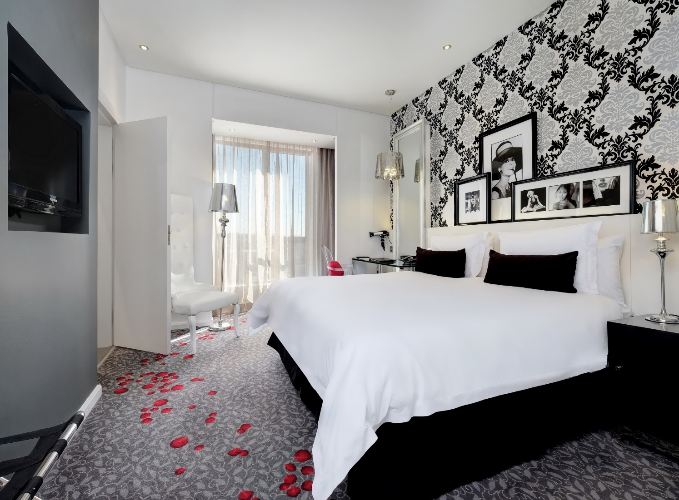
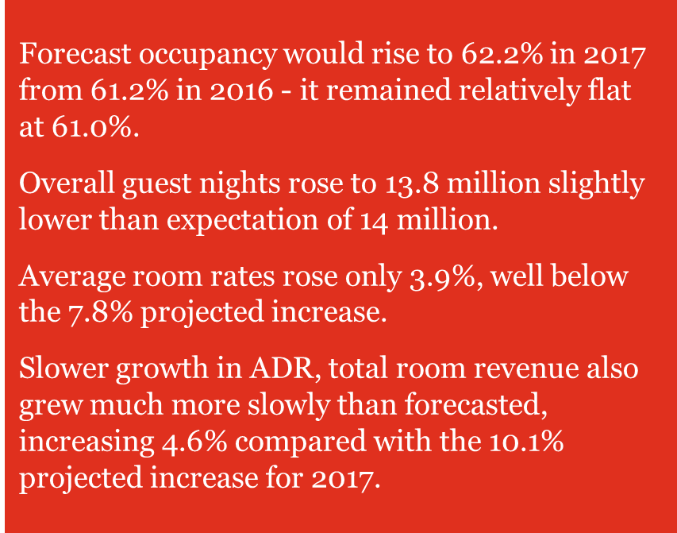
Looking back
South Africa

Slide 15
Outlook: 2018 - 2022
South Africa
  Available rooms
  Occupancy
Larger increase in available rooms in 2018, accounting for a 1.8% gain
Increase at a 0.9% compound annual rate to 64 900 in 2022 from 62 000 in 2017
Occupancy increasing to 62.5% in 2022 from 61.0% in 2017
  Total room revenue
Expand at a 5.6% compound annual rate to R21.8 billion in 2022, from
R16.6 billion in 2017.

Slide 16
Hotel accommodation in Mauritius

Slide 17
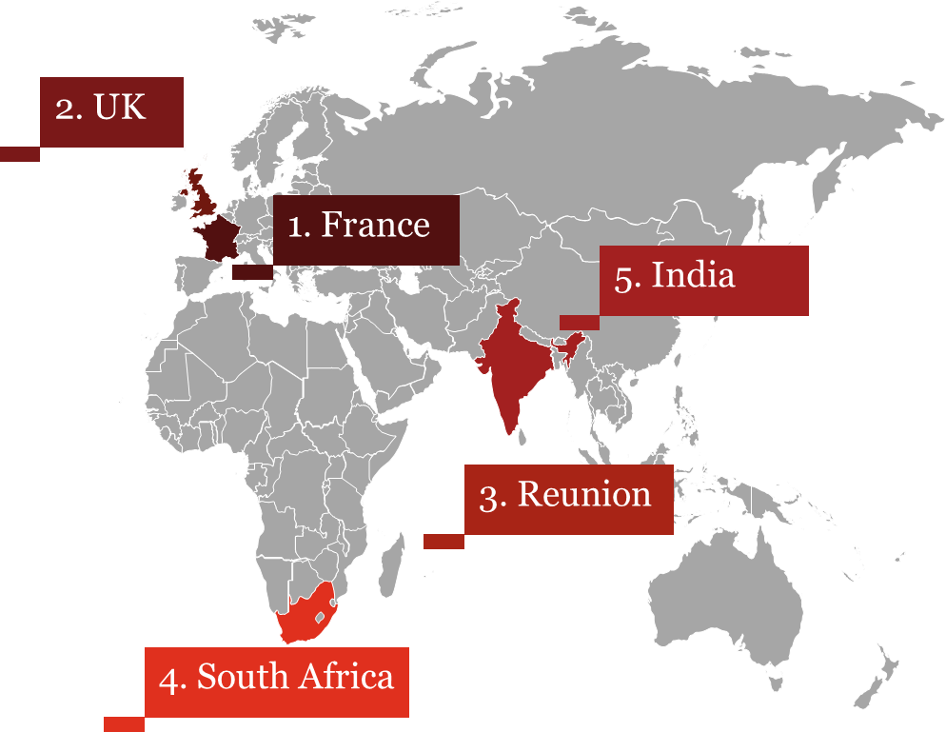
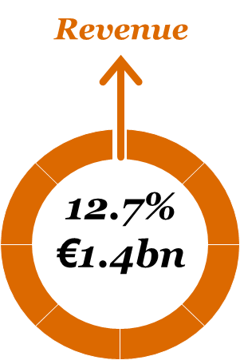
Top 5 visiting countries
  Tourism contributed 8% to Mauritius GDP in 2017, while providing 10% of active employment in the country and attracting 8% of investments
  Average length of stay was 10.9 nights
  Mauritius has 114 hotels, with a total capacity of 29 656 bed places
  5.2% increase in tourists arrival with a total arrival of 1341.86m tourists
  France remains leading source of tourists, amounting to 20% of total arrival
Mauritius
Room Revenue

Slide 18
Hotel revenue
Mauritius
Room Revenue
3* & 4* (combined) | Revenue of EUR179m in 2017, increase of 11.9% 54.0% (2016: 53.1%) occupancy in 2017 & ADR of EUR128
5* | Revenue of EUR354m in 2017, increase of 16.4% 72.7% (2016: 64.3%) occupancy in 2017 & ADR of EUR272

Slide 19
  Looking back: 2017
  Guest nights, tourism and occupancy rates were a bit lower than we predicted, but the total room revenue growth of 12.7% was above our 8.0% prediction.
  Three-, four- and five-star hotels all exceeded our expectations for room revenue growth.
Mauritius

Slide 20
Mauritius destination positioning
Mauritius
Room Revenue
The Government’s Three-year Strategic Plan 2018-21
Revision of promotional strategy
Liberalisation of air access
Diversification of offering
Upskilling of workforce to uphold quality of service delivery
Cruise Market
Mauritius targeting the cruise market with the objective of becoming a ‘preferred fly/cruise gateway’ to the Indian Ocean
Wedding & High-net worth individuals destination
Mauritius opening up as a stand-out destination for investors with a growing expatriate community.
The island is also benefitting from the global trend of overseas weddings.
Impact of GDPR A number of large hotel groups have started their compliance journey and are making substantial investments to achieve compliance in a sustainable and demonstrable manner.

Slide 21
Hotel accommodation in Nigeria

Slide 22
Second quarter of 2017, the Nigerian economy began to recover. Real GDP rose 0.8% for 2017 as a whole.
97% of tourist spending in Nigeria in 2017
having been generated by domestic travellers.
Guest nights rose 6.7% in 2017, the first increase since 2013.
Nigeria remains an attractive
market for international hotel brands because of its large
economy.

Slide 23
Nigeria
Past five years, the total number of available rooms rose a cumulative 21%
Forecast period as a whole, the number of available rooms will rise from 9 700 in 2017 to
12 600 in 2022, a 5.4% compound annual increase
Nigeria’s overall hotel market outperformed our expectations in 2017.
The average room rate increased 4.8% in 2017. Overall hotel room revenue is expected to expand at a 12.6% compound annual rate to $380 million (N136.8 billion) in 2022 from $210 million (N75.6 billion) in 2017.

Slide 24
Hotel accommodation in Kenya

Slide 25
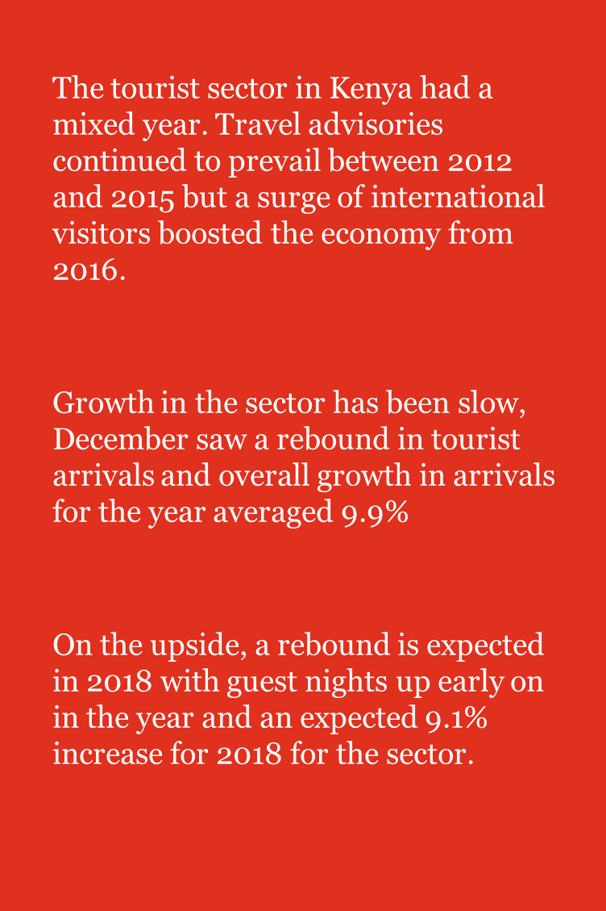
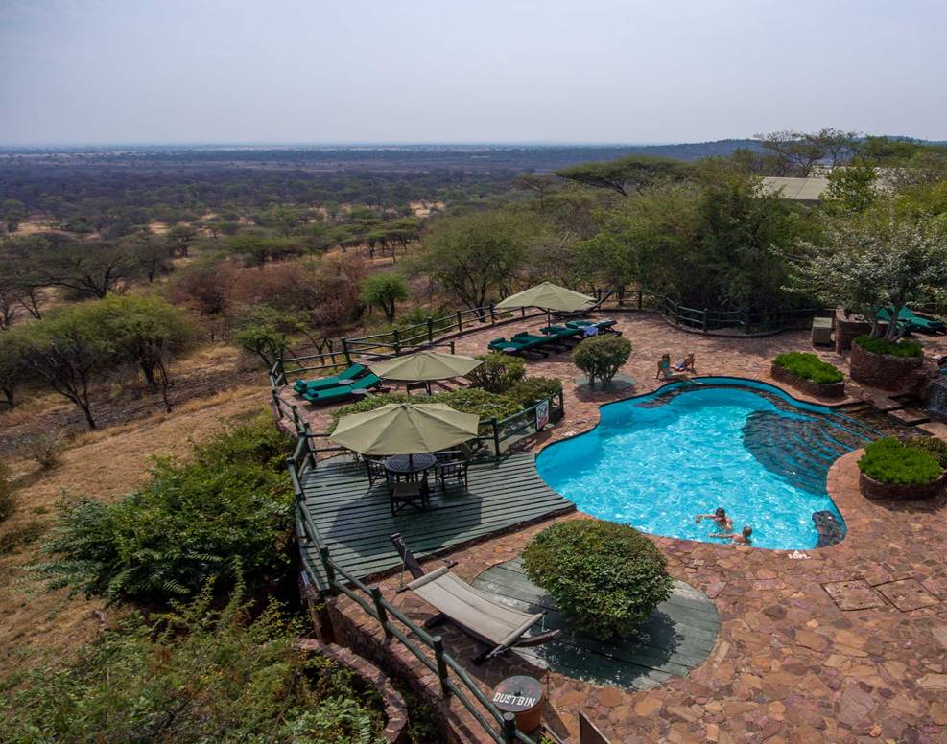
Kenya

Slide 26
Kenya
  Projected number of available rooms to increase from 19,100 in 2017 to 21,700 in 2022, a 2.6% compound annual increase.
  Guest nights will total an estimated 4.6 million in 2022, a 6.9% compound annual increase from 3.3 million in 2017. It is projected the Average Daily Rate (ADR) to increase from $132 (R1 630) in 2017 to $150 (R1 852) in 2022, a 2.6% compound annual increase.
  Total room revenue will expand by 9.6%, compounded annually, rising to $690 million (R8.5 billion) in 2022 from $436 million (R5.4 billion) in 2017.

Slide 27
Hotel accommodation in Tanzania

Slide 28
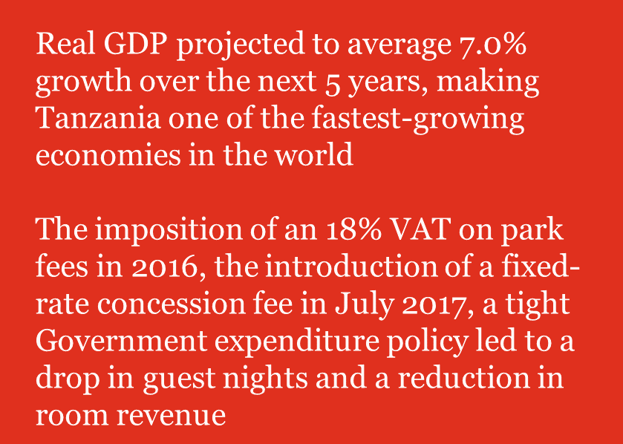
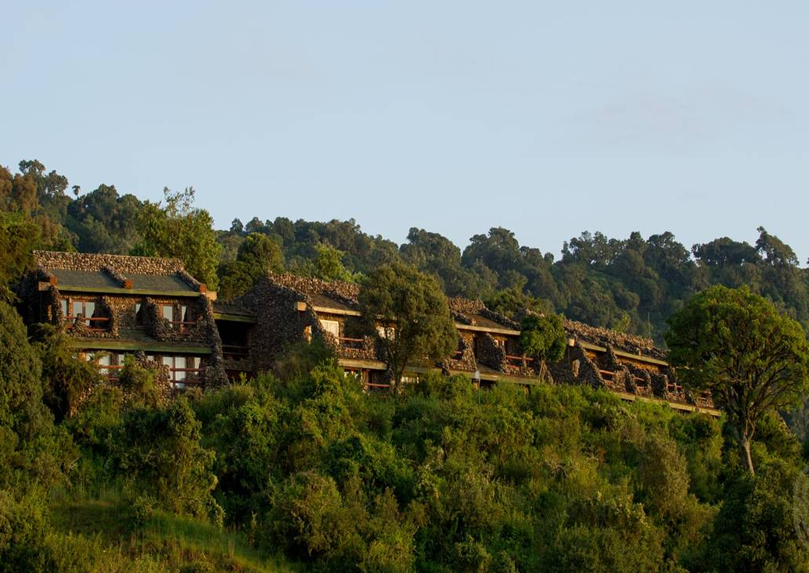
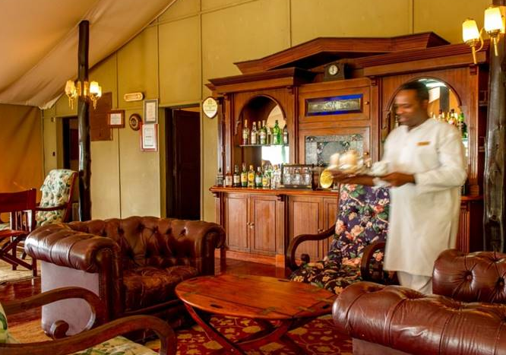
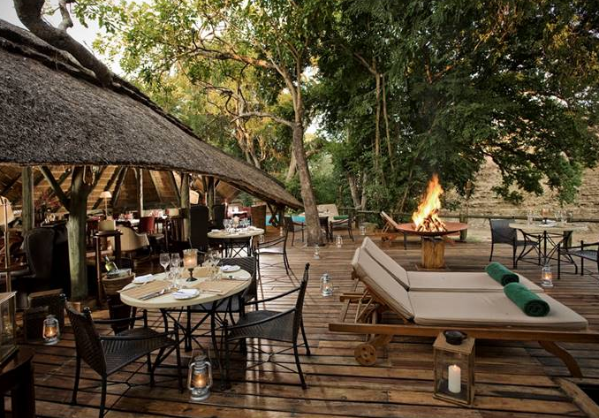
Tanzania

Slide 29
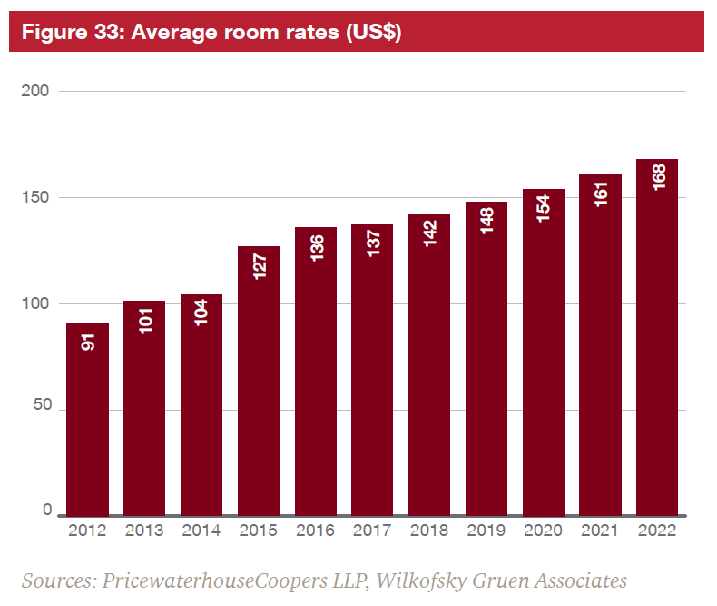
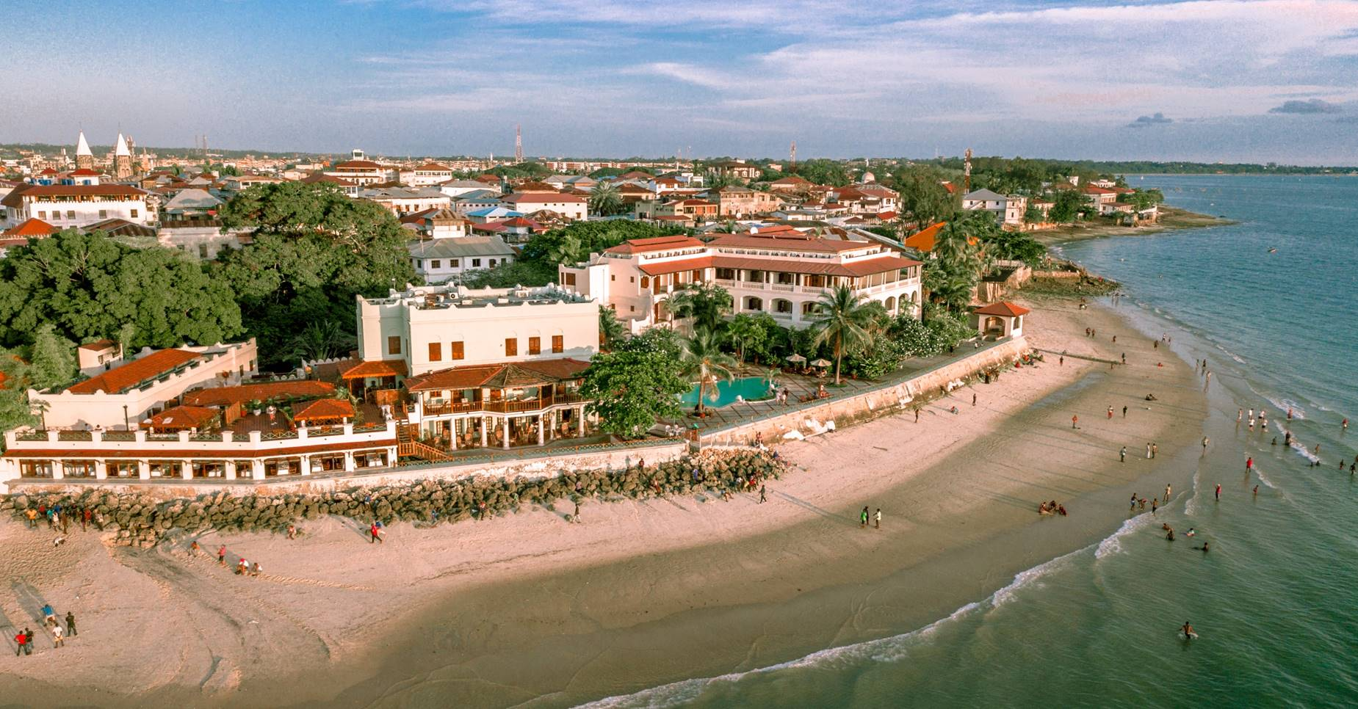
Tanzania
  Seven new hotels in Tanzania, most of which will be opened in the next two years
  After rising by 22.6% in 2015, and 7.7% in 2016, the average room rate growth was flat in 2017. Room revenue fell by 5.5% in 2017, down from the 7.7% increase in 2016
  However total room revenue is expected to expand by 9.1% compounded annually, rising to $319 million in 2022 from $206 million in 2017

Slide 30
Cybersecurity and privacy: do you know the risks you are taking?

Slide 31

Trust, confidence and brand health may operate in a different time frame to share prices.
The absence of share price volatility does not mean that trust, confidence and brand health are not being eroded. If that is true, then the logic points, perhaps, to a convergence in the future of value erosion.
In other words, suffering cybersecurity and privacy failures might be like a cancer, where the harm is hidden from view until it is too late.
Cybersecurity and privacy
59% of security leaders say digitisation has increased information security spending.

Slide 32
Cybersecurity and privacy
  In our experience, organisations have had to travel a significant distance from their starting point to levels of acceptable GDPR compliance.

Slide 33
In order to properly bring together the interests of economic advantage, risk management and compliance with legal obligations, entities need to develop an appropriate vision for their desired end state.
That vision will take account of the entity’s ‘special characteristics’ and the points of view of all necessary stakeholders.
People responsible for cybersecurity and privacy in hotels ought to ask themselves whether their organisations have appropriate visions for desired end states. If not, they should bring together the stakeholders to discuss ways to take things forward.
Cybersecurity and privacy

Slide 34
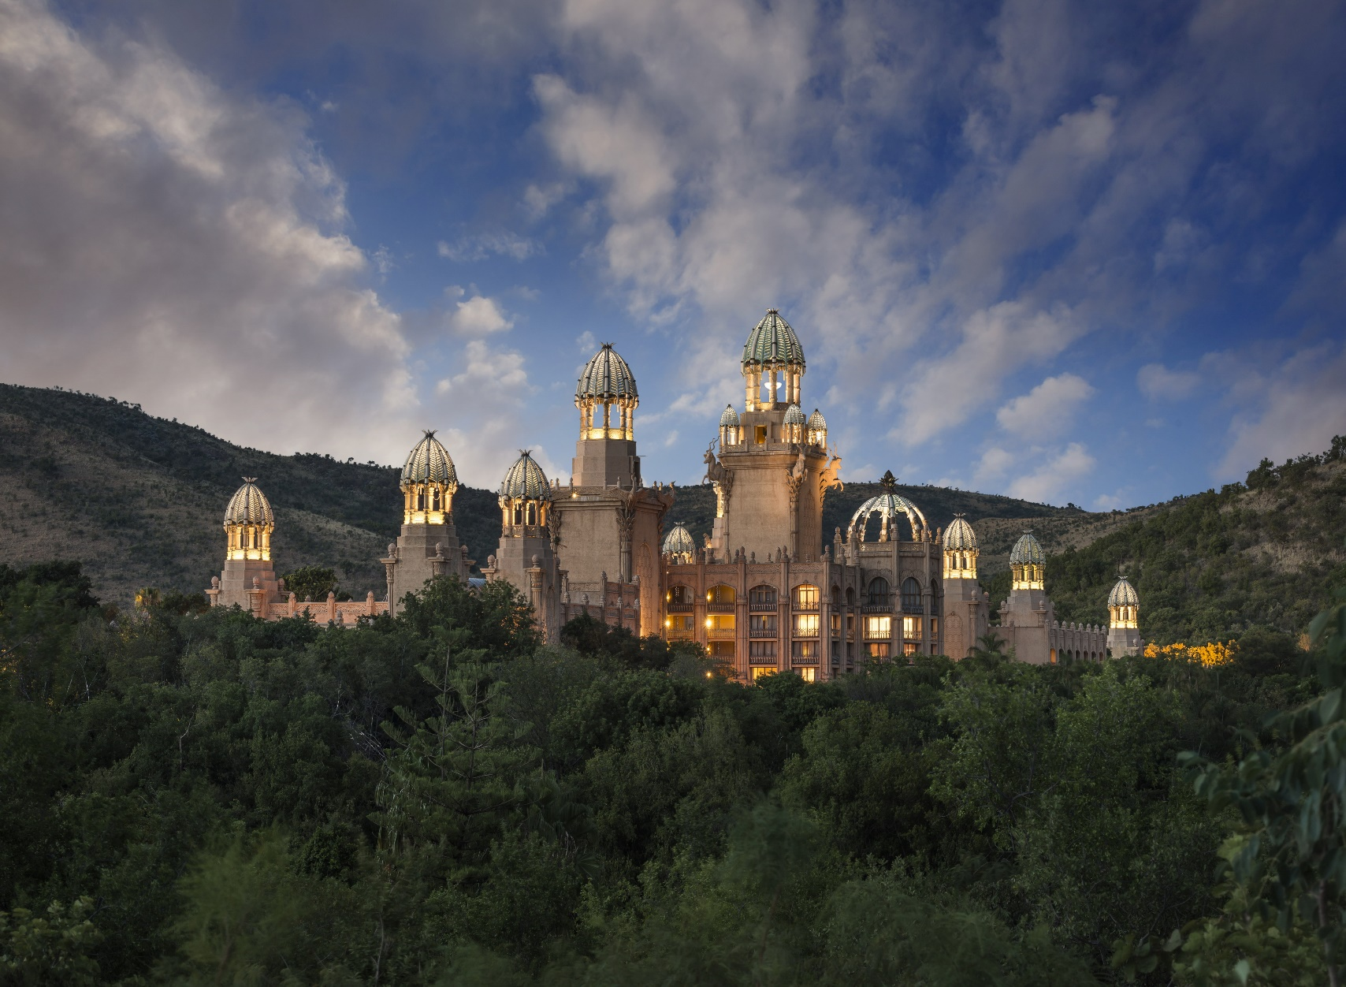
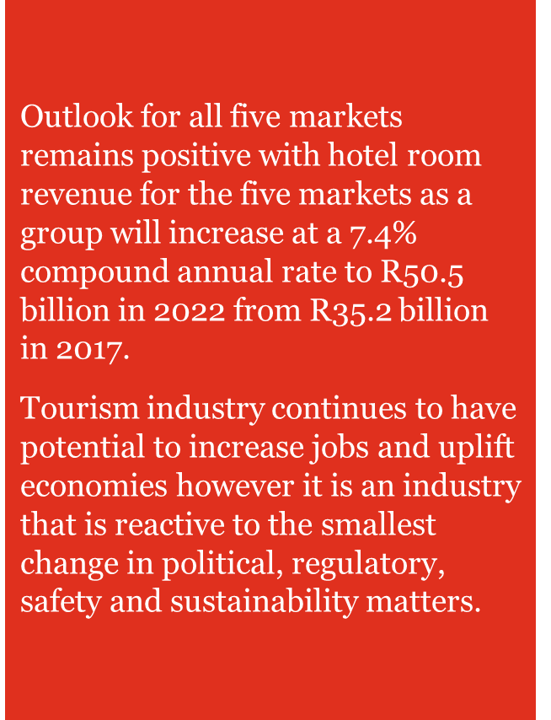
In closing….

Slide 35





Links
  www.pwc.co.za/hospitality-and-leisure
  @pwc_za
  PwC South Africa
  pietro.calicchio@pwc.com
  +27 11 797 5292
“The information contained in this publication by PwC is provided for discussion purposes only and is intended to provide the reader or his/her entity with general information of interest. The information is supplied on an “as is” basis and has not been compiled to meet the reader’s or his/her entity’s individual requirements. It is the reader’s responsibility to satisfy him or her that the content meets the individual or his/ her entity’s requirements. The information should not be regarded as professional or legal advice or the official opinion of PwC. No action should be taken on the strength of the information without obtaining professional advice. Although PwC take all reasonable steps to ensure the quality and accuracy of the information, accuracy is not guaranteed. PwC, shall not be liable for any damage, loss or liability of any nature incurred directly or indirectly by whomever and resulting from any cause in connection with the information contained herein.”
© PwC Inc. [Registration number 1998/012055/21](“PwC”). All rights reserved. PwC refers to the South African member firm, and may sometimes refer to the PwC network. Each member firm is a separate legal entity. Please see www.pwc.co.za for further details.

